Slide 1

Software Design and Analysis Interaction Diagrams Sequence Diagram & Communication Diagram
Department of Computer Science
National University of Computer and Emerging Sciences

Slide 2
Interaction Diagrams
The term interaction diagram, is a generalization of two more specialized UML diagram types:
Sequence diagrams
Communication/Collaboration diagrams.
Both can be used to express similar message interactions.
Sequence diagrams are the more notationally rich of the two types.

Slide 3
Sequence Diagram
Sequence diagrams illustrate interactions in a kind of fence format, in which each new object is added to the right.

Slide 4
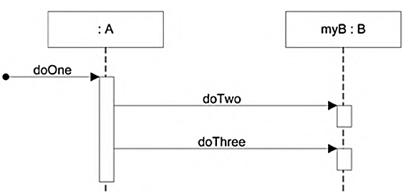
Sequence Diagram
Sequence Diagram
Code Representation
public class A { private B myB = new B();
public void doOne() { myB.doTwo(); myB.doThree(); } // … }
Code representation: Class A has a method named doOne and an attribute of type B. Also, that class B has methods named doTwo and doThree.

Slide 5
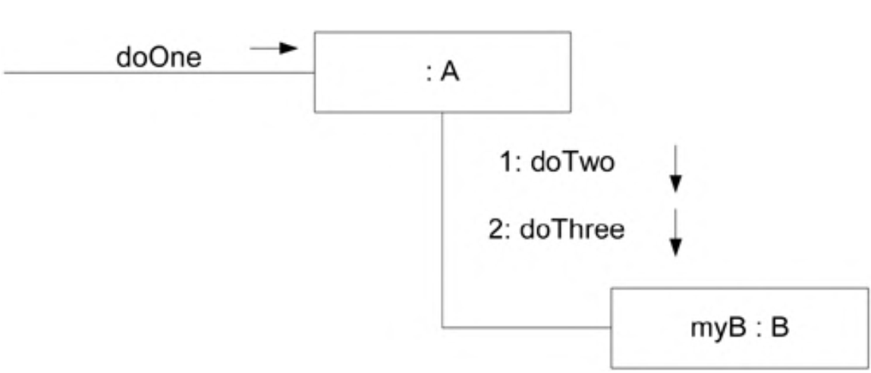
Communication Diagram
Communication diagrams illustrate object interactions in a graph or network format, in which objects can be placed anywhere on the diagram.

Slide 6
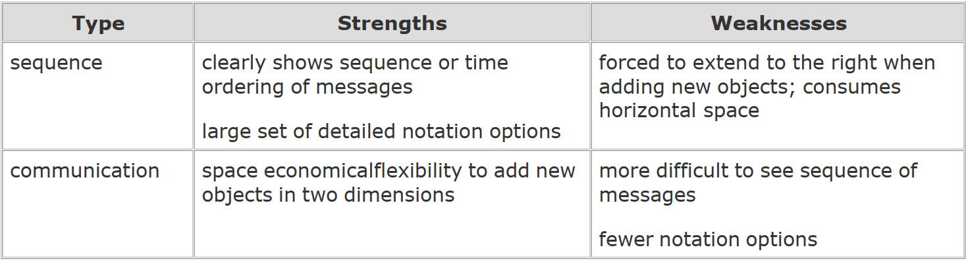
Strengths and Weaknesses

Slide 7
Example Sequence Diagram: makePayment
1. The message makePayment is sent to an instance of a Register. The sender is not identified. 2. The Register instance sends the makePayment message to a Sale instance. 3. The Sale instance creates an instance of a Payment.

Slide 8
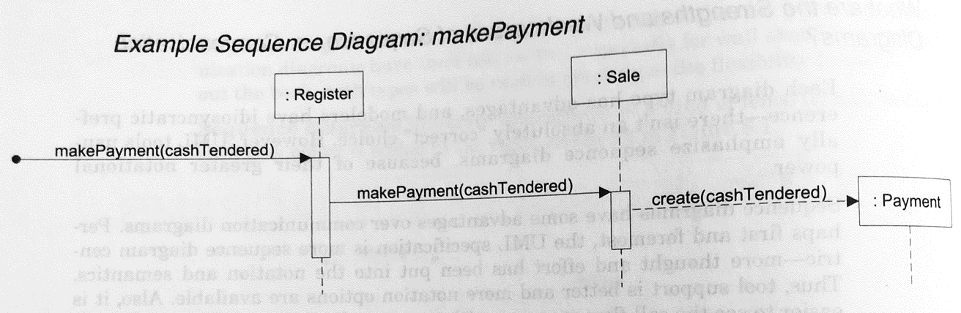
Example Sequence Diagram: makePayment

Slide 9
Example Sequence Diagram: makePayment
Code for the Sale class and its makePayment method
public class Sale { private Payment payment; public void makePayment( Money cashTendered ) { payment = new Payment( cashTendered ); //… } // … }

Slide 10
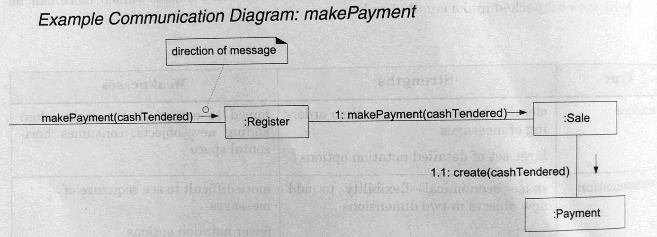
Example Sequence Diagram: makePayment

Slide 11
Common UML Interaction Diagram Notation
Illustrating Participants with Lifeline Boxes In the UML, the boxes you've seen in the prior sample interaction diagrams are called lifeline boxes.
They represent the participants in the interaction. .

Slide 12
Basic Message Expression Syntax
Interaction diagrams show messages between objects; the UML has a standard syntax for these message expressions:
return = message(parameter : parameterType) : returnType
Parentheses are usually excluded if there are no parameters, though still legal.
Type information may be excluded if obvious or unimportant.
For example:
initialize(code) initialize d = getProductDescription(id) d = getProductDescription(id:ItemID) d = getProductDescription(id:ItemID) : ProductDescription

Slide 13
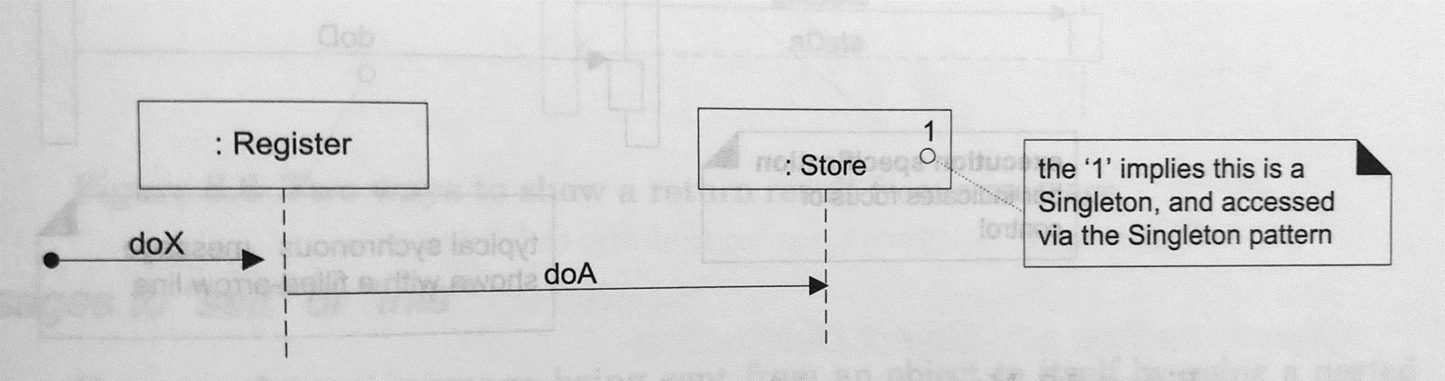
Basic Message Expression Syntax
In the world of OO design patterns, there is one that is especially common, called the Singleton pattern.
There is only one instance of a class instantiated, never two.
In other words, it is a "singleton" instance.
In a UML interaction diagram (sequence or communication), such an object is marked with a '1' in the upper right corner of the lifeline box.

Slide 14
Basic Sequence Diagram Notation
Lifeline Boxes and Lifelines
In contrast to communication diagrams, in sequence diagrams the lifeline boxes include a vertical line extending below them - these are the actual lifelines.
Although all UML examples show the lifeline as dashed (because of UML 1 influence).
In fact the UML 2 specification says it may be solid or dashed.

Slide 15
Basic Sequence Diagram Notation
Messages
Each (typical synchronous) message between objects is represented with a message expression on a filled-arrowed solid line between the vertical lifelines.
The time ordering is organized from top to bottom of lifelines.

Slide 16
Basic Sequence Diagram Notation
Focus of Control and Execution Specification Bars
Sequence diagrams may also show the focus of control using an execution specification bar (previously called an activation bar or simply an activation in UML 1).
The bar is optional.

Slide 17
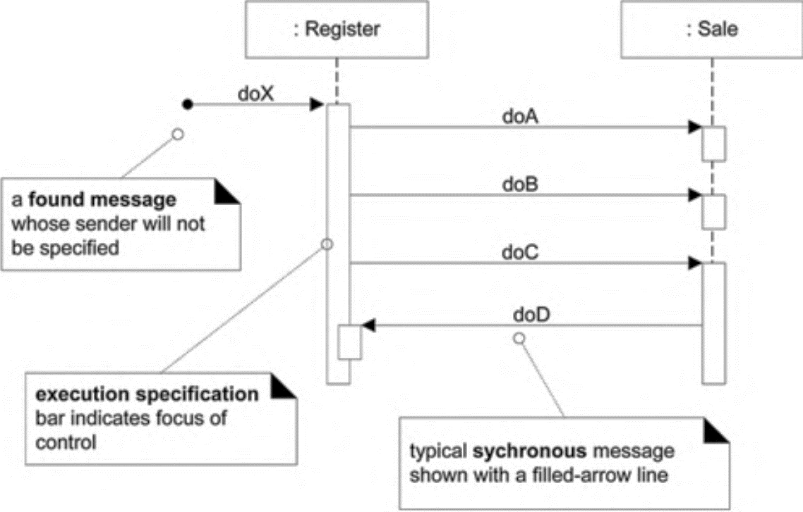
Basic Sequence Diagram Notation
Focus of Control and Execution Specification Bars

Slide 18
Basic Sequence Diagram Notation
Illustrating Reply or Returns There are two ways to show the return result from a message: 1. Using the message syntax returnVar = message(parameter). 2. Using a reply (or return) message line at the end of an activation bar. Both are common in practice.
If the reply line is used, the line is normally labelled with an arbitrary description of the returning value.

Slide 19
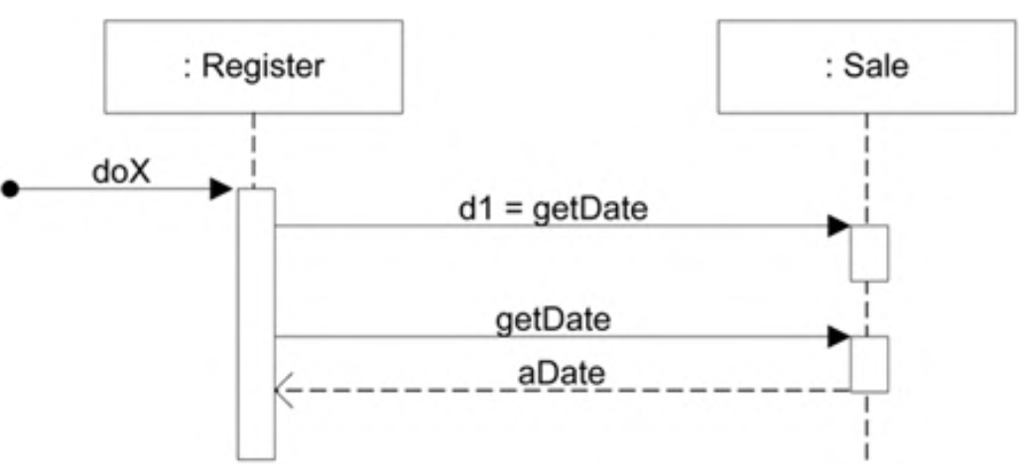
Basic Sequence Diagram Notation
Illustrating Reply or Returns

Slide 20
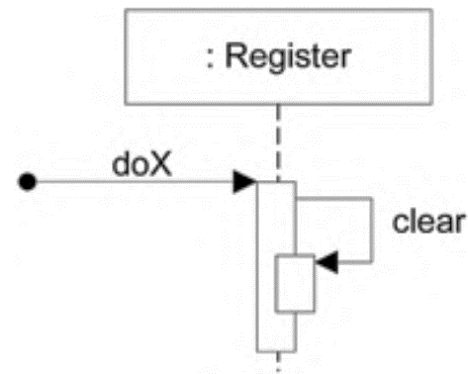
Basic Sequence Diagram Notation
Messages to "self" or "this“
You can show a message being sent from an object to itself by using a nested activation bar.

Slide 21
Basic Sequence Diagram Notation
Creation of Instances
Object creation notation is shown in below. Note the UML-mandated dashed line.
The arrow is filled if it's a regular synchronous message or open (stick arrow) if an asynchronous call.
The message name create is not required .

Slide 22
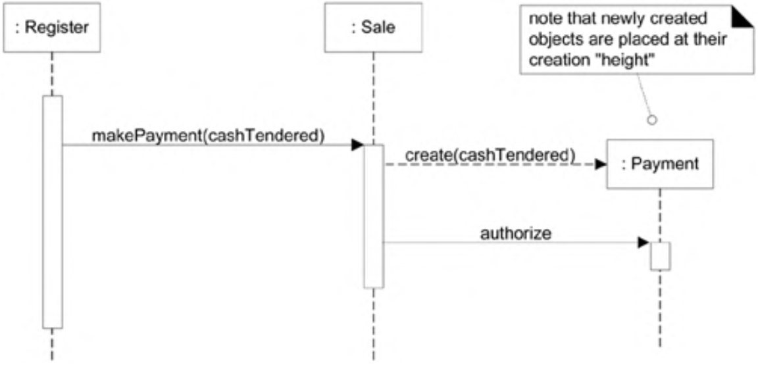
Basic Sequence Diagram Notation
Creation of Instances

Slide 23
Basic Sequence Diagram Notation
Object Lifelines and Object Destruction
In some circumstances it is desirable to show explicit destruction of an object, For example,
When using C++ which does not have automatic garbage collection,
When you want to especially indicate an object is no longer usable (such as a closed database connection).
The UML lifeline notation provides a way to express this destruction. .

Slide 24
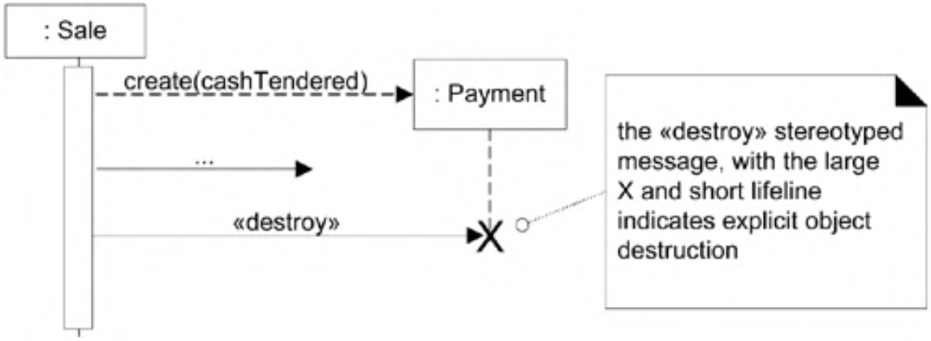
Basic Sequence Diagram Notation
Object Lifelines and Object Destruction

Slide 25
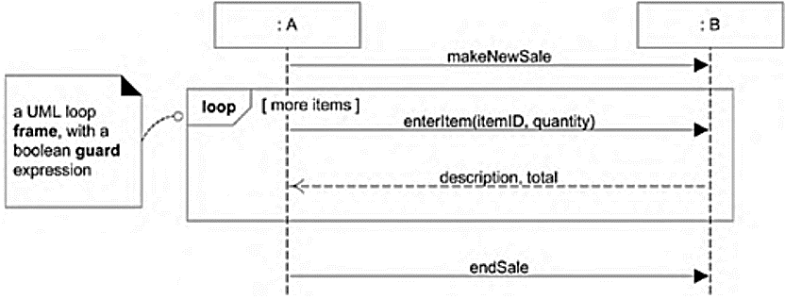
Diagram Frames in UML Sequence Diagrams
Frames
To support conditional and looping constructs (among many other things), the UML uses frames.
Frames are regions or fragments of the diagrams; they have an operator or label (such as loop) and a guard (conditional clause).

Slide 26
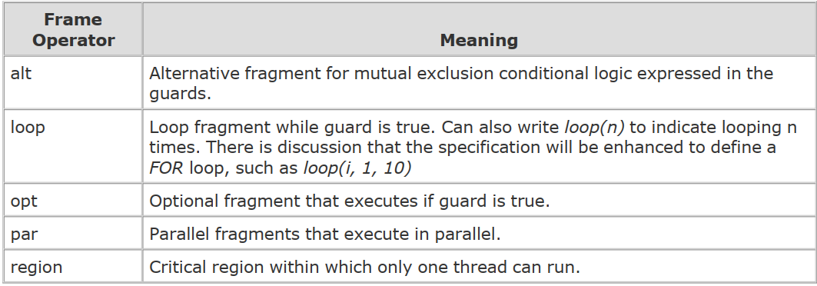
Diagram Frames in UML Sequence Diagrams
Frame Operations:

Slide 27
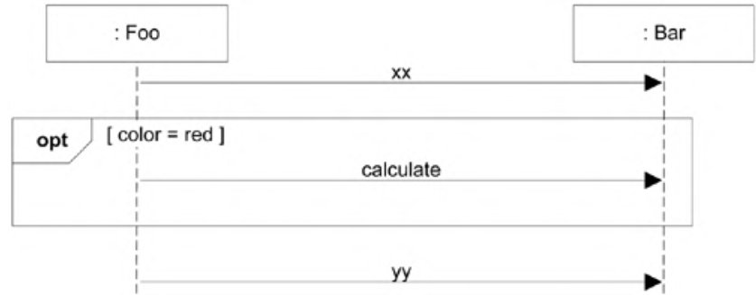
Diagram Frames in UML Sequence Diagrams
Conditional Messages
An OPT frame is placed around one or more messages. Notice that the guard is placed over the related lifeline.

Slide 28
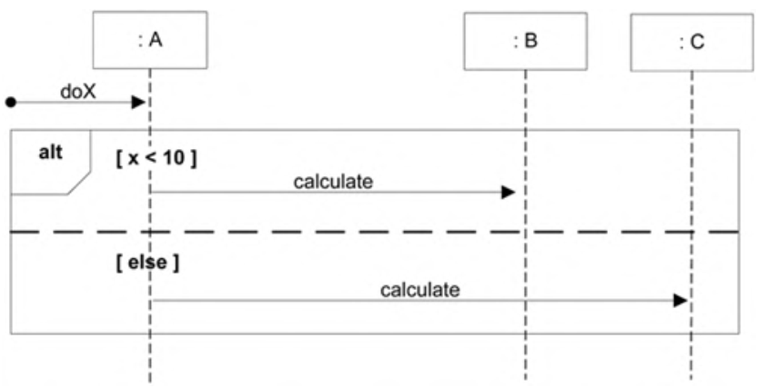
Diagram Frames in UML Sequence Diagrams
Mutually Exclusive Conditional Messages
An ALT frame is placed around the mutually exclusive alternatives.

Slide 29
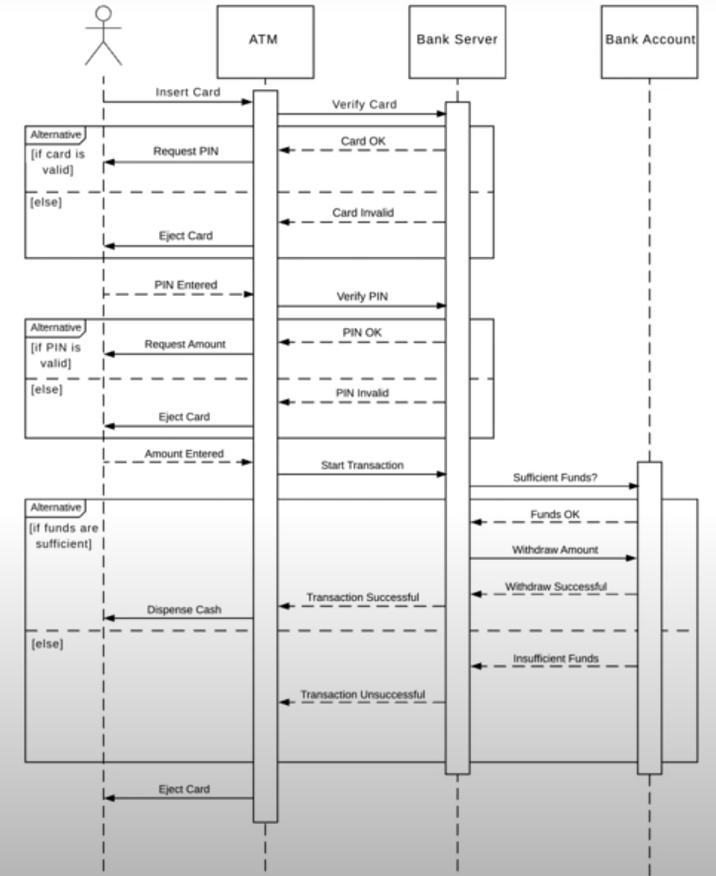

Slide 30
Task:
A patient is suffering from a critical health situation; he/she immediately needs to be admitted into the hospital. At first, the patient arrived at the reception of a hospital and requested the receptionist for registration. The receptionist will add the patient's details into the patient’s database. After that, the patient will request for the ward allocation. If any of the wards is available, his/her case will be entertained and a specific ward (with a ward number) will be allocated to him/her; otherwise he/she will be informed about the unavailability of the ward.
Draw a sequence diagram for the given scenario by carefully considering the following aspects:
You need to show the interaction of four objects, including Patient, Receptionist, Patient’s Database, and Ward, along with their lifelines. Clearly draw the activation boxes/action execution specifications for the aforementioned objects during their lifelines.
When the patient requests the receptionist to allocate a ward, the availability of the ward is checked first. If the ward is available, his/her request will be entertained and the ward will be updated with the patient's details; otherwise, he/she will be informed about the unavailability of the ward.
Since the patient is in a critical situation, he/she immediately needs to be admitted into a ward. Therefore, the ward availability is checked several times until his/her request is successfully entertained.
Once the ward has been allocated to the patient, considering his/her critical health situation, a request to install the ventilator facility can be made. Therefore, you need to create a new object to indicate the installation of a ventilator in the ward.
Assume that the patient's health situation is stable now, so he/she not need the ventilator anymore. Therefore, you need to destroy the ventilator object after it has been used for a specific period of time.

Slide 31
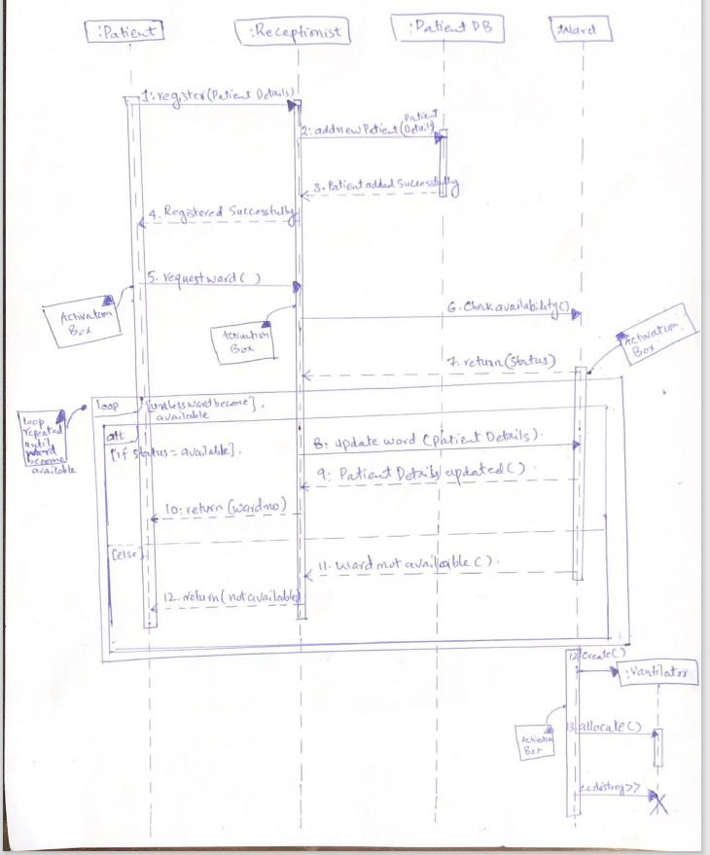

Slide 32
End of Lecture Any Question ?

